Slide 1

Introduction to Computer Science Using R: A Course for Analysts
Lesson 1: An Overview of Computer Science

Slide 2
References & Texts
I recommend the following resources, which I have made copious use of in developing this material:
Paul D. Crutcher, Neeraj Kumar Singh, and Peter Tiegs
Essential Computer Science, A Programmer’s Guide to Foundational Concepts
APress / Springer Nature, 2021 https://doi.org/10.1007/978-1-4842-7107-0
Garrett Grolemund
Hands On Programming in R
O'Reilly and Associates, 2014 http://bit.ly/HandsOnR
Homer White
Beginning Computer Science with R
Georgetown College https://homerhanumat.github.io/r-notes/index.html

Slide 3
A brief history of computers and networks

Slide 4

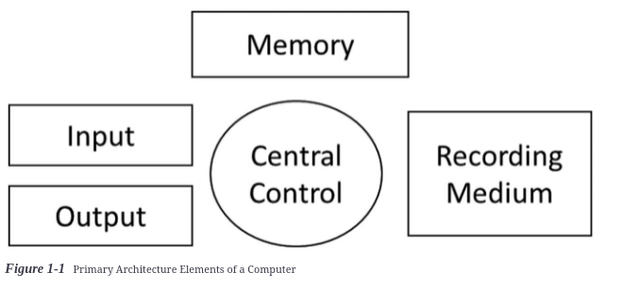
The von Neumann Model
1970s – Intel, first general-purpose microprocessor, called the 8088
IBM used it to make the first PC small enough for personal use
But 30 years earlier (in the 1940s), John von Neumann documented the primary elements of a computer system
We still use his model today to describe these systems:
The "Central Control" is also called the CPU, or central processing unit. The job of the CPU is to "fetch, decode, execute, and store the results of instructions" but although people call the CPU the "brain" of the computer, the computer only does what it is programmed to do!

Slide 5
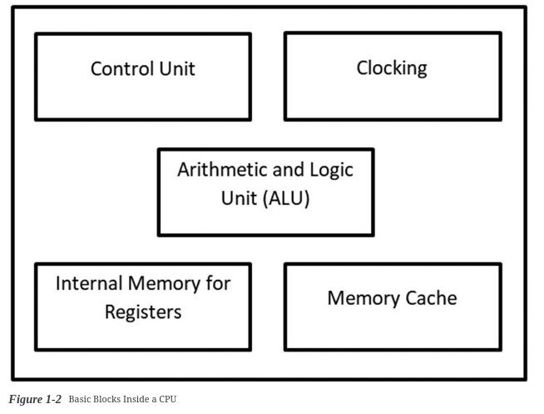
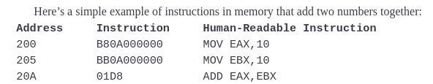
Fetch, Decode, Execute & Store
Fetch: The CPU fetches instructions from memory using addresses.
Each address has a finite amount of memory associated with it, just as your home mailbox has a fixed capacity.
Example:
Meaning
EAX = 10
EBX = 10
EAX + EBX
Parts of the CPU
Decode: The CPU interprets an instruction and transfers the data needed to execute the instruction into the CPU to perform the instruction.
Example: the instruction at address 20A above, tells the CPU to add the value stored in EAX and the value stored in EBX. The CPU determines what data this is and passes it to the ALU for addition.

Slide 6
Fetch, Decode, Execute & Store
Execute: The ALU performs the operations delegated to it, for example addition, subtraction, multiplication and division, including division with remainder.
Store: Based on the instructions provided, the CPU will store values either in a particular address location or in special memory locations called registers. Registers are used to store values in the CPU that help it execute instructions without having to refer to items stored in a particular address location.
For instance, when executing many consecutive arithmetic instructions, the CPU will store all the interim values in a register and store only the final value in the address location designated.
Parts of the CPU
value stored at address
A90
120
132
in register
Address allocated
N = 2^3 * 15 + 12

Slide 7
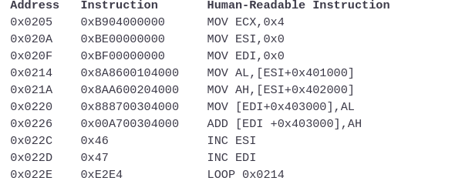
Those Things CPUs Do...
They COUNT
As they keep track of things they do, they count these things.
They REPEAT THEMSELVES
They can execute a series of instructions over and over – this is called a loop. When you write programs, you will tell the computer how to loop over instructions!
They STACK THEIR WORK
Computers make stacks of the instruction blocks they are executing. They push new items onto the top of the working memory "stack", then they pop those items off. The stack works on a last-in, first-out paradigm (LIFO), sort of like gin rummy.
They POINT TO THINGS
Rather than transfer all these instruction blocks here and there, the CPU can treat a pointer to the beginning of a series of instructions as a single item, and a pointer to another as another single item. This helps the CPU work faster.
start of function
loop
These instructions tell the computer to add numbers in one list to numbers in another list and store the output in a third list.
When programmers write an instruction set like this, they call it a function. When calling a function, they tell the computer to use the instructions pointed to at a particular place in memory.

Slide 8
From Simple to Complex
While we just saw that the building blocks of a computer system are relatively simple, in the modern world these simple building blocks are layered on top of each other in a way that adds up to a LOT of complexity.
First, consider the complexity of a single computer – such as your desktop computer...
Software: All Programs
All Other Applications
Operating System (OS)
But modern applications are also connected to the internet...
What about that?
Hardware: CPU (and other parts), monitor (output), keyboard (input), mouse(input), speakers (output), printer (output)

Slide 9










Even More Complex...
1971 – DoD's ARPANET – the first Network.
15 computers
Packets & Routing
Protocols
Simple software that enables
data transfer
Telnet
Email (SMTP)
File Transfer (FTP)
Today, we take the idea of
the Network for granted, but it
represents the true beginning of
today's technical age!
Server
Router

Slide 10




The early network's struggles
Before the invention of TCP / IP, there were protocols, but they wouldn't work on every system.
Early networks also had issues with message-reassembly
When sending a message or file from one system to another, the
message or file had to be broken down into small units, and each
unit had to be "wrapped" in a transfer protocol program.
These segments, often called packets, then had to be reassembled
correctly once they all arrived at their destination. Often, they
wouldn't all arrive, or they wouldn't arrive in order.
So, there had to be a way to make sure the full message or file arrived and could be reassembled properly.

Slide 11
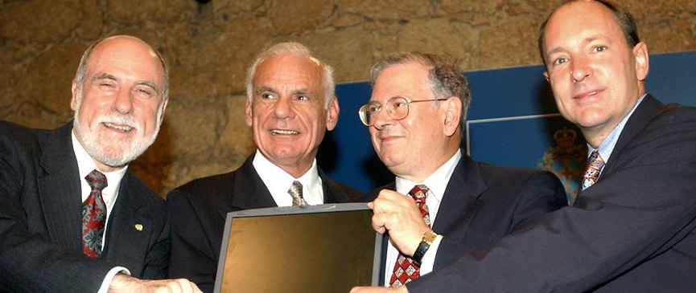
Heroes you may never have heard of
Bob Kahn Ph.D. EE
Co-inventor of TCP/IP
Vinton G. Cerf Ph.D. CS
Co-inventor of TCP/IP
Tim Berners-Lee BA Physics
Inventor of HTTP, HTML and Web browsing
Larry Roberts Ph.D. EE
Inventor of routing / packet switching

Slide 12




TCP / IP – the dawn of a new era
Stands for "Transmission Control Protocol" / "Internet Protocol"
IP actually came first – this is how we identify computers on a network, by their "IP addresses", and transfer data between them
IP doesn't work without TCP, however. TCP chunks the message or file to be sent up into segments and labels them so they can be kept track of, re-assembled in the right order, and re-requested if one goes missing!
TCP
TCP
IP
IP
128.67.44.6
TO: 181.69.21.2
FROM: 128.67.44.3
181.69.21.2
Router

Slide 13
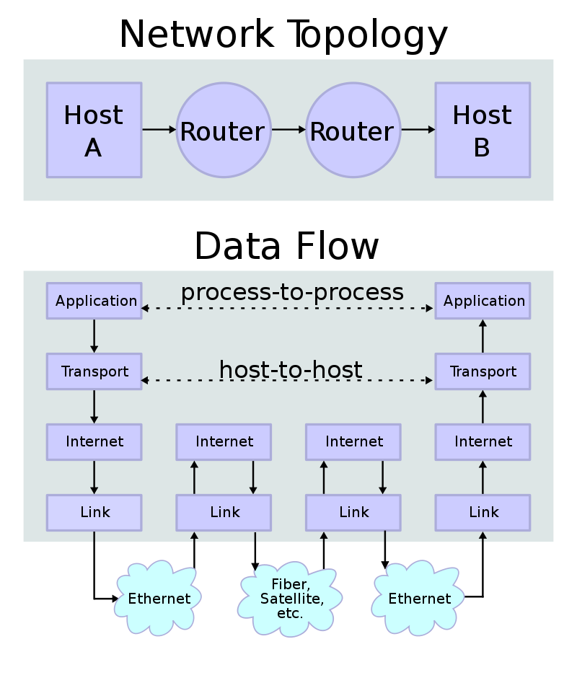

From protocol to paradigm
Because TCP / IP solved these fundamental issues, networking then took off!
Everyone started adopting the protocols for use in their systems, making it possible to send messages and files from one computer to another, regardless of manufacturer or operating system. Thus, the vision behind TCP / IP became the common paradigm used to describe how networks function.
Vroom!!
4 layers
By en:User:Kbrose - Prior Wikipedia artwork by en:User:Cburnett, CC BY-SA 3.0, https://commons.wikimedia.org/w/index.php?curid=1831900

Slide 14
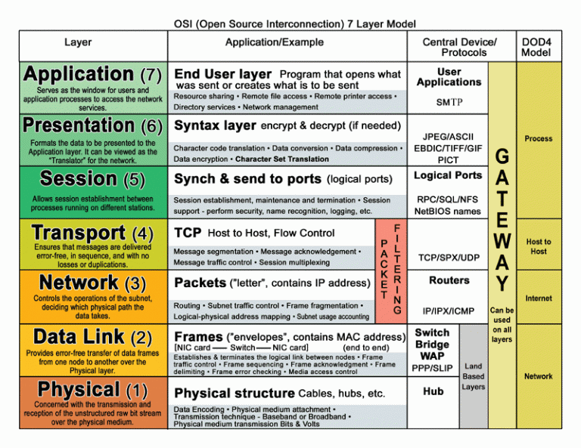
Representing the complexity
1984 – the OSI model (Open Systems Interconnection Reference Model)
Builds on the TCP / IP model's four layers
For the internet-connected application to work, all these layers must function properly!

Slide 15

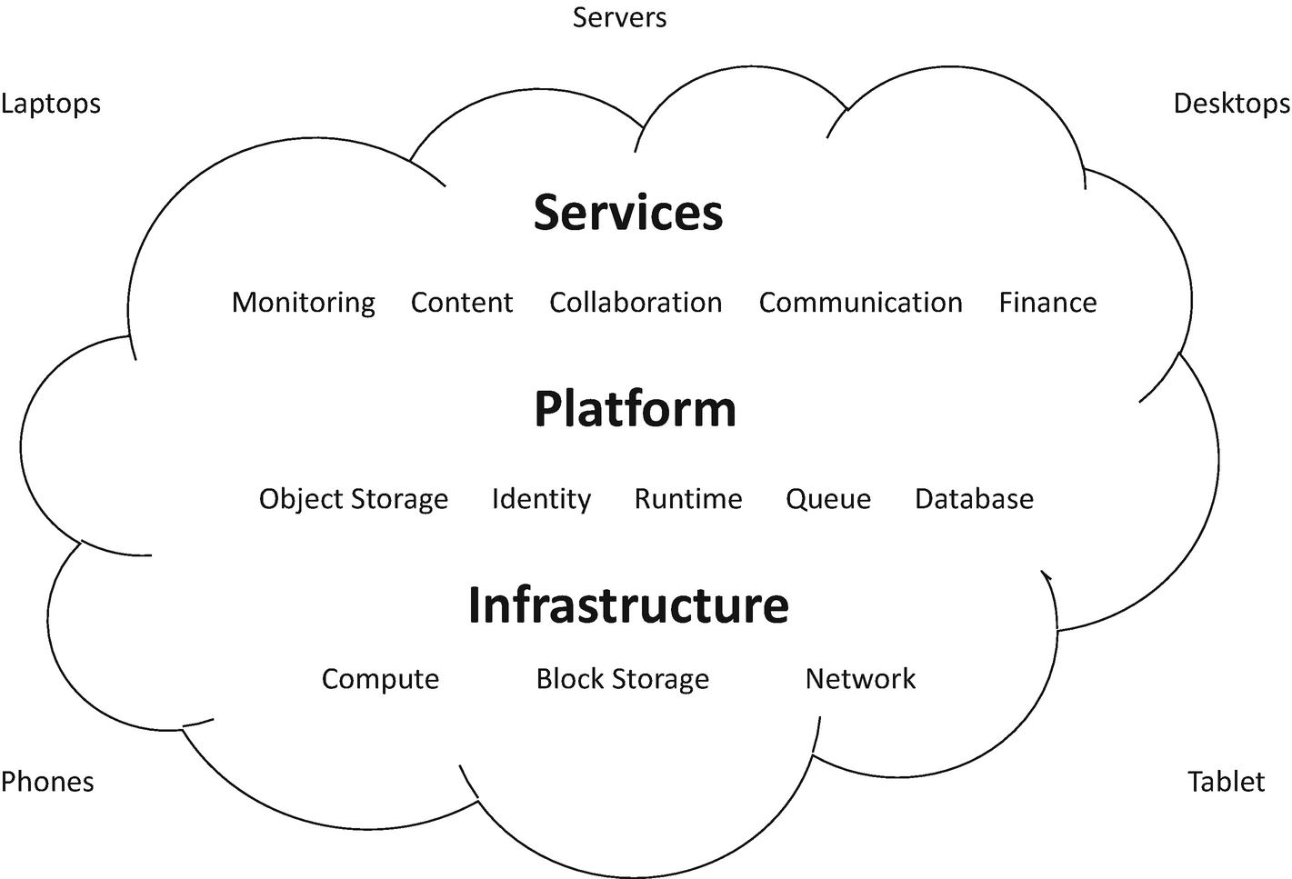
The consolidates resources elsewhere
As the network architecture and world wide web matured and became more and more reliable & robust, it became possible to access hardware & software remotely instead of building a server in your home or business in order to make use of the network.

Slide 16
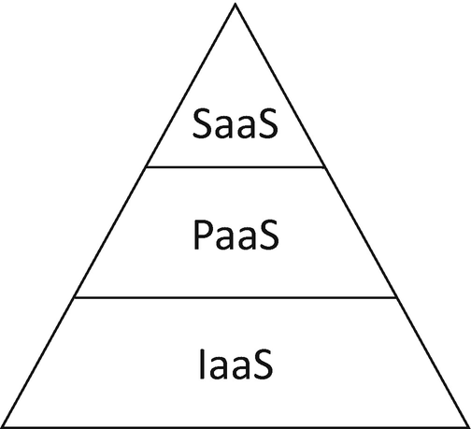










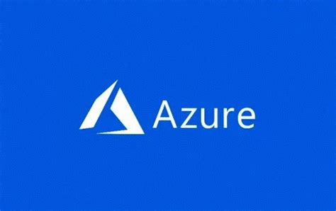
The cloud stack
SaaS (Software as a Service):
Ability to use a software application over the internet without worrying about any aspect of development, deployment, and maintenance
The PaaS layer includes FaaS (Function as a Service), remote execution of code without having to write or maintain it
PaaS (Platform as a Service):
Access an on-demand environment for developing, testing, delivering, and managing software services
FaaS
IaaS (Infrastructure as a Service):
Provision, manage & access hardware over the internet

Slide 17
Communicating with machines

Slide 18
Those Things CPUs Do...Revisited
All computing is finite – the amount of work depends on the amount of resources
Computers can do complex things, but they do them one step at a time
Computers don't really "learn", but they can play by the rules in some really neat ways
If you can describe a game using math, the computer can optimize its performance in that game
You can use a program to create another program based on information you don't have yet
Instructions telling the computer to add numbers in list 1 to corresponding numbers in list 2 and put the results in list 3.

Slide 19
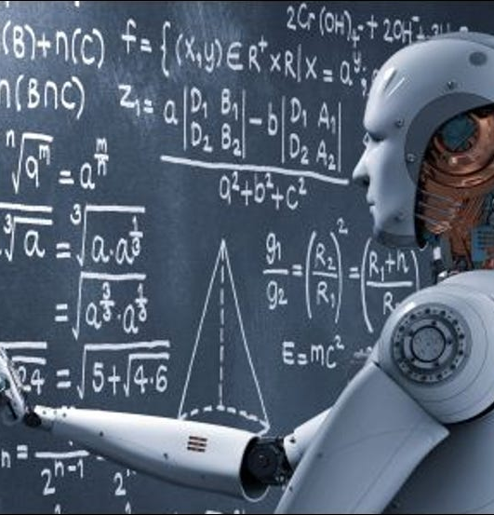
AI is not AGI
AI, or "Artificial Intelligence" is not actually intelligent (yet) in the sense that machines do not truly think or understand. A machine that could do these things, would have AGI - "Artificial General Intelligence"
Neural networks and machine learning are cool, but they are a long way from being able to produce AGI.
Machine learning involves the application of a sophisticated mathematical or statistical rule-set to data that has been proven to extract valuable information from the data
A neural network is a computer program with multiple layers that each data input passes through, and each layer applies a mathematical or statistical rule-set to the data, assigning different weights and probabilities at each pass, before ultimately making a determination

Slide 20
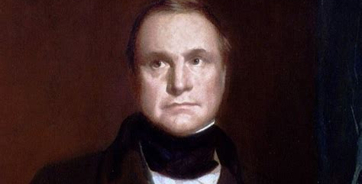
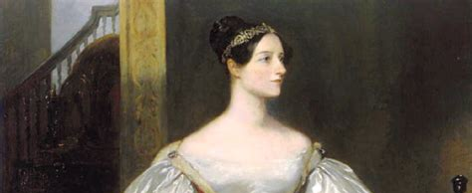
Programming: how we communicate with computers
Charles Babbage: inventor of the computer
Since the beginning of the "analytical engine" (1837) people have worked with computers
Computers are ridiculously good at math, but we have to organize anything we want the computer to do into a series of instructions that can be carried out one at a time
If we want the computer to do something less obvious (like "read" a book) we have to devise a way to represent that task using math
We accomplish all of this using a programming language
Ada Lovelace: one of the first algorithm developers

Slide 21
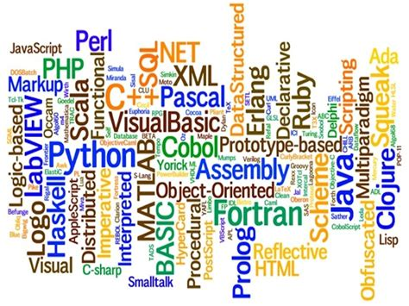
Programming languages
Translate human-readable instructions into instructions the computer can carry out
Some languages are compiled: changed into a format only the computer can read before they are executed
Other languages are interpreted: another layer of software changes the instructions into a computer-readable form as the program executes
All languages have strengths and weaknesses, philosophical foundations and apply to a wide variety of problems
Languages, like skirt-lengths, go in and out of fashion
All programmers have favorite languages, but there is no best language - only the best language for the job

Slide 22

Based on what we know about computers so far, what features do you think programming languages might share?

Slide 23
Remember "Fetch, Decode, Execute & Store"?
Most commonly-used languages have:
Variables: a way to store data
Typing: a way to classify data
Instructions: basic routines that do something to data
Math operations
Receive input and create output
Control structures: ways to control which instructions happen when or loop through instructions
Functions or methods: ways to group together sets of instructions and control structures that perform an operation we will reuse

Slide 24




As usual, we can then build more complexity...
data structure
algorithm
A Data Structure is a way of collecting and organising data so we can efficiently perform operations on the data
Class
Linked list
Tree
Graph
Dataframe or table
An Algorithm is a set of instructions or logic, written in order, to accomplish a certain predefined task
An algorithm should:
Take input- There should be 0 or more inputs supplied externally to the algorithm.
Create output- There should be atleast 1 output obtained.
Have definiteness- Every step of the algorithm should be clear and well defined.
Have finiteness- The algorithm should have finite number of steps.
Have correctness- Every step of the algorithm must generate a correct output.
Ideally, be efficient and fast- take less time to execute and consumes less memory space

Slide 25
What is R?

Slide 26

The R language
R is a programming language and freely-available software environment, primarily for data organization, cleaning and statistical computing, graphics and machine learning
R is stronger in statistics than machine learning, but is rapidly growing in this area
R is improved and maintained by the R Core Team and by enterprising users
August 2021 – R ranked 14th in popularity among programming languages

Slide 27


Why is it called R?
C, FORTRAN
S, S-PLUS, Scheme
R
R's predecessor was a language called...S
S was created for statistical computing
Similar: APL & MATLAB
tryapl.org

Slide 28
The Anaconda Environment
🐍
The anaconda environment is a commonly-used data science programming platform
It is very easy to self-document code in this environment
Working code is valued over documentation, but documentation is still important – we want to think of those who come after us
Many people also use python – another important data science language – in this environment

Slide 29
Homework – Week 1
Download and install Anaconda Individual Edition on your machine of choice: https://www.anaconda.com/products/individual
Detailed installation documentation is available here: https://docs.anaconda.com/anaconda/install/
Once this is complete, follow the instructions here to install and enable R Notebooks, and create your first notebook!
https://docs.anaconda.com/anaconda/navigator/tutorials/r-lang/
Reach out to me if you have any problems or questions – email, Teams, Zoom bomb, etc.

